Slide 1

Nature’s Symphony
(Discovering Floral & Avian Wonders)
Vanshika Salve (21107010)
Sanchit Patil (21107001)
Khushi Chhoker (21107055)
Project Guide
Ms. Aavani Nair

Slide 2
Contents
Introduction
Objectives
Scope
Features / Functionality
Project Outcomes
Technology Stack
Block Diagram

Slide 3
1. Introduction
Nature’s Symphony predicts the different types of flowers species and the migration pattern of various birds species by analysing various factors of birds and flowers, this system connects us with the natural world .
Problem Identified :
Limited ability to predict and understand the behaviors of birds and various flowers species in natural ecosystem.
Solution Proposed :
User can identify different types of species of birds as well as flowers easily.

Slide 4
2. Objectives
To identify and classify both birds species and flowers species
To analyse and predict the migrational behaviour of birds and specific types of flowers
To increase the knowledge about birds and flowers to the user
To develop user-friendly interfaces
To Provide information about the bird species and flower species

Slide 5
3. Scope
Tourism and Birdwatching: Tourist guides and birdwatchers can benefit from prediction tools that help them to identify specific bird species in different regions.
Agriculture: Planting choices based on predicted zones suitable for birds-flowers interactions.
Urban Planning: In urban planning, understanding the types of birds and flowers in an area can be used to design more environment friendly and sustainable cities and parks.
4. Education: It can be used for educational purposes to teach people about the natural world.

Slide 6
4. Feature /Functionality
1. User can predict species of flower by selecting Floral by providing following inputs
i. colour ii. no of androecium iii. no of gynoceium iv. sitgma
v. style
2. Their germination data graphs can be tracked.
3. User can predict species of birds by selecting Avian by providing following inputs
i. primary colour ii. Secondary colour iii. no of legs\hands iv. Flight
v. zone
4. Their migration data graphs can be tracked.

Slide 7
5. Outcome of Project
1. User Can Register and login\log out
2. User can predict flowers and birds by using two options Avian
and Floral.
3. If Avian is selected, user will be able to know about species of birds.
4. If Migration is selected, user will be able to know the migrational behavior of bird.
5. If Floran is selected, user will be able to know species of flowers.
6. If Germination is selected, user will be able to know the germination data of flower.

Slide 8
6. Technology Stack
1.Python 3.11.5
2.Mysql 8.0.1
3.Matplotlib 2.13.0
4.Google Colab 1.1.2
Algorithm used: K-Nearest Neighbour (KNN)
Data set used in Floral: plant_dataset dataset of size (599 KB, 850 Rows, 9 Columns)
Data set used in Avian: bird_data_set dataset of size (0.97 Mb, 800 rows, 10 columns)

Slide 9
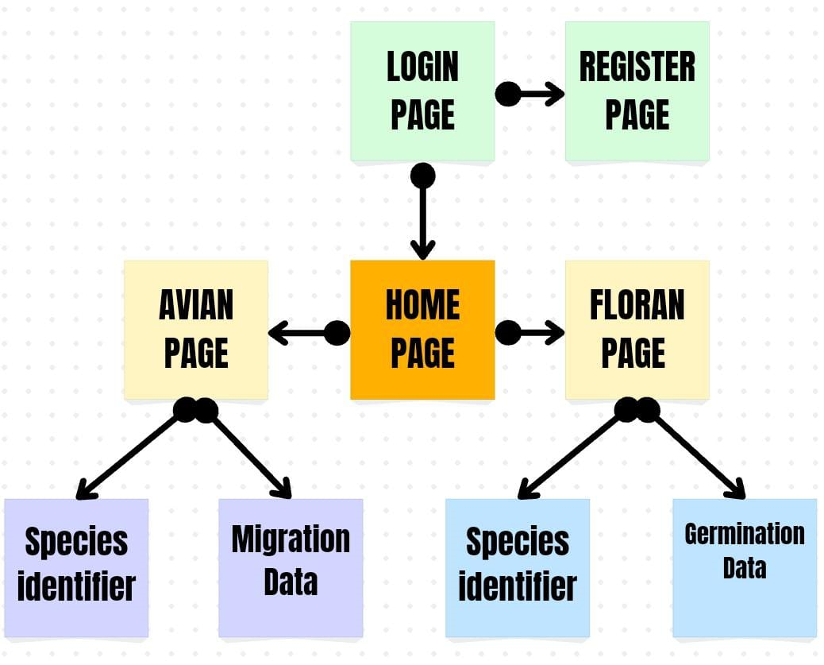
7. Block Diagram

Slide 10
Thank You...!!

